Slide 1
Heart Disease Prediction Using Machine Learning
By
Bhushan Ajay Waghode

Slide 2
INTRODUCTION
What is Machine Learning ?
Goal of the Project
What is Supervised Learning ?

Slide 3
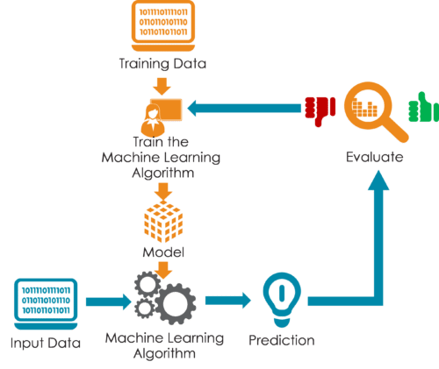

Slide 4
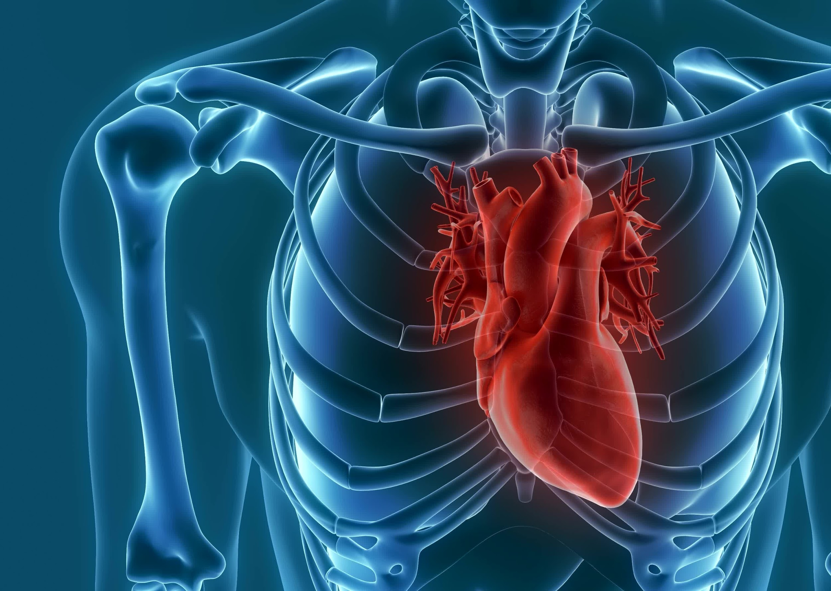
The Working of the Project

Slide 5

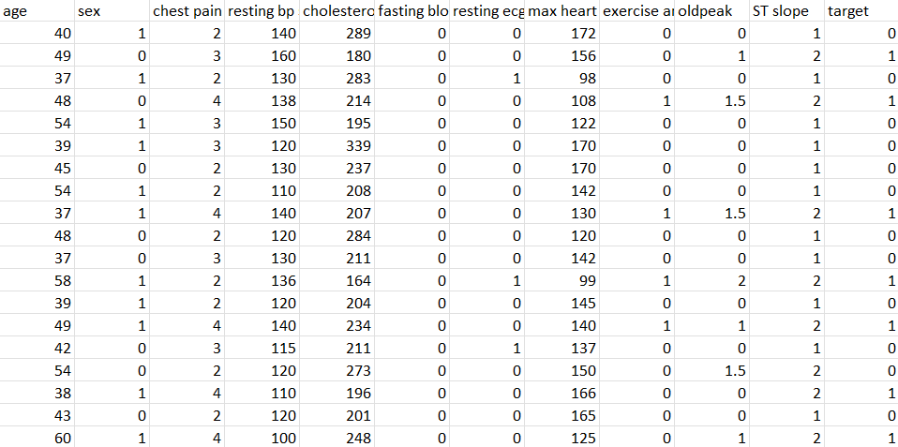
Dataset

Slide 6
3 step process
Split the dataset
Train the dataset
Compare the Algos

Slide 7

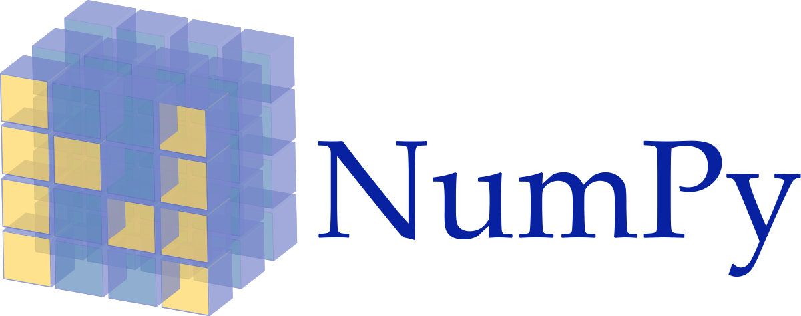




Slide 8
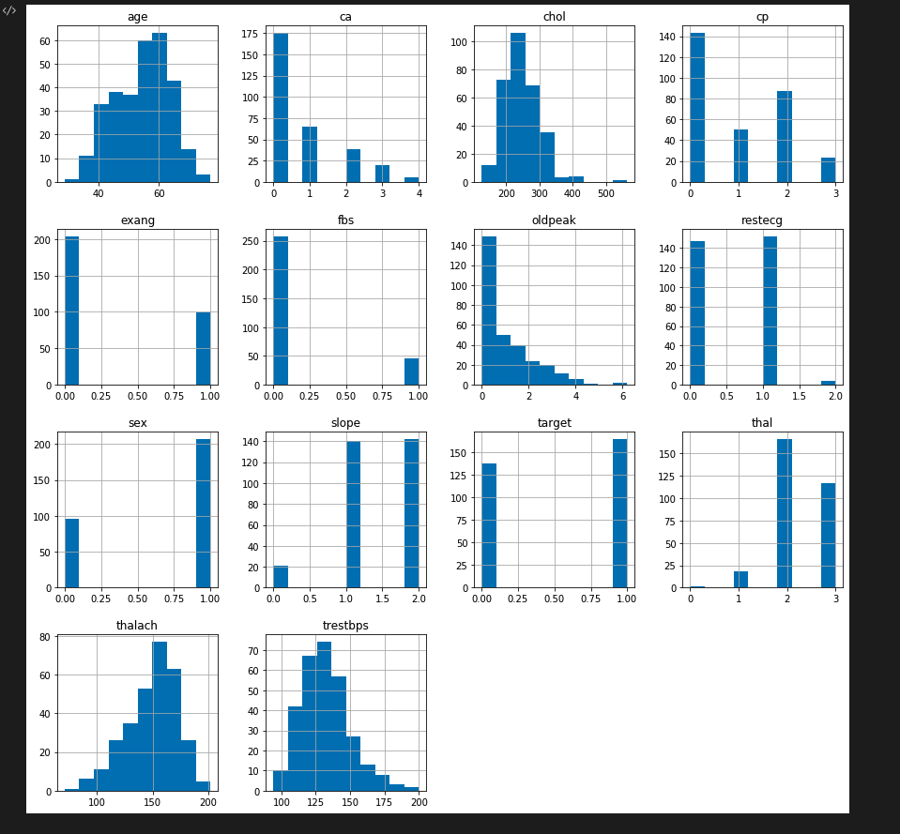
Data visualization

Slide 9
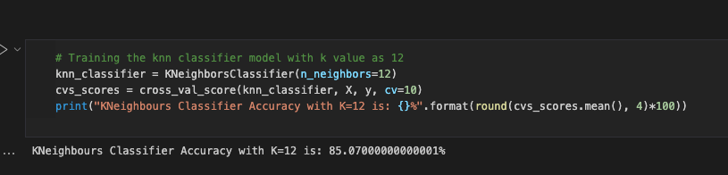
KN eighbours clasifier

Slide 10
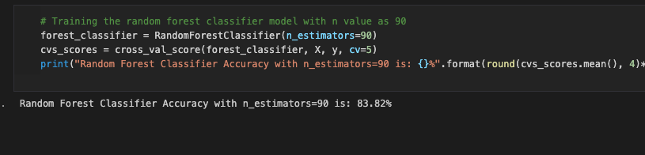
Random Forest

Slide 11
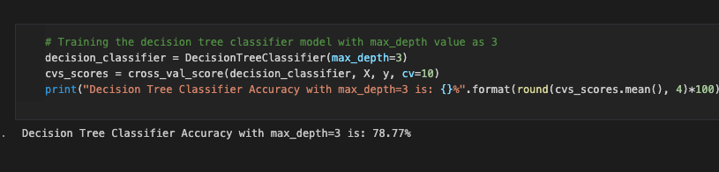
Decision Tree Classifier

Slide 12
Conclusion
We have best three algorithms for predicting the heart disease through given datasets. We are also getting best accuracy. It is one of the new system that use three famous algorithm for prediction of diseases especially heart.

Slide 13


